Slide 1
WELCOME Acceptance and Integration Training Melanie McGhee, L.C.S.W.
www.aait.solutions

Slide 2
Acceptance and Integration Training
Helping ourselves and our clients wake up from the bad dream of who we think we are, shifting identification from the conditioned self to the true self.
www.aait.solutions

Slide 3
The true self is not encumbered by the limitations of a narrative. The true self is a being.

Slide 4
Where We’re Going
Origins of Acceptance and Integration Training
Principles, Phases & Theory
Basic PEAT for Emotional Regulation – Demo, Discussion, Practice
Deep PEAT 4 for Problem Resolution, Shadow Integration and Goal Achievement
Introduction to Trauma Treatment with AAIT – Demo, Discussion, Practice
Golden Shadow Integration with Deep PEAT 4.

Slide 5
False Conditioned Self
Traumas
Early decisions
Injunctions
Scripts
Identities
Wounds
Limiting Beliefs
Mental Illness
Cognitive Distortions
Etcetera

Slide 7
AAIT is Informed by the Confluence of Five Streams of Knowledge
Ericksonian Hypnosis
Redecision Therapy
Self Acceptance Training & Hypnosis0
Nondual Philosophy
PEAT (Prime Energy Activation and Transcendence)

Slide 8
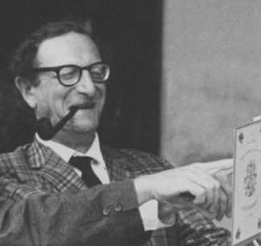
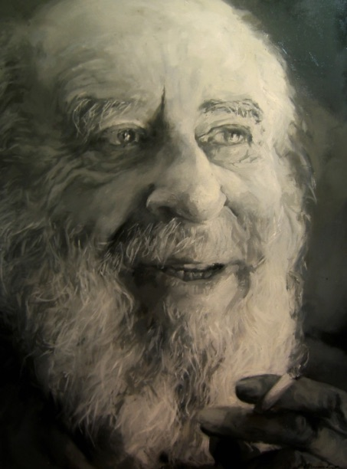
Redecision Therapy grew from the genius of Bob and Mary Goulding who studied with psychotherapy thought leaders and the founders of Transactional Analysis and Gestalt Therapy.
Eric Berne, M.D.
Mary Goulding, L.C.S.W. Bob Goulding, M.D.
Fritz Perls, M.D.

Slide 9
“Self Acceptance Training is experiencing myself as I am in a given moment without the inhibition of self criticism, self judgment or self evaluation.”
~ Dick Olney

Slide 10
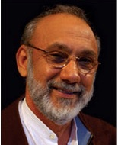
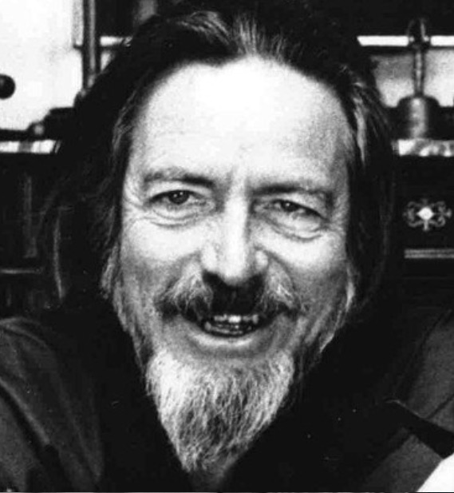
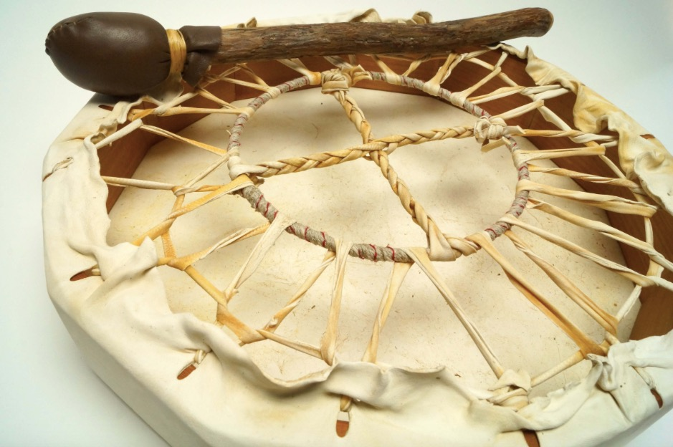
Self Acceptance Training
A.H. Almaas, Ph.D.
Fritz Perls, M.D.
Dick Olney, M.A.
Alan Watts
Studied with two shamans
Alexander Lowen, M.D.
Akhter Ahsen, Ph.D.

Slide 11
All variety of things are manifestations of one thing and only appear to be two.

Slide 12
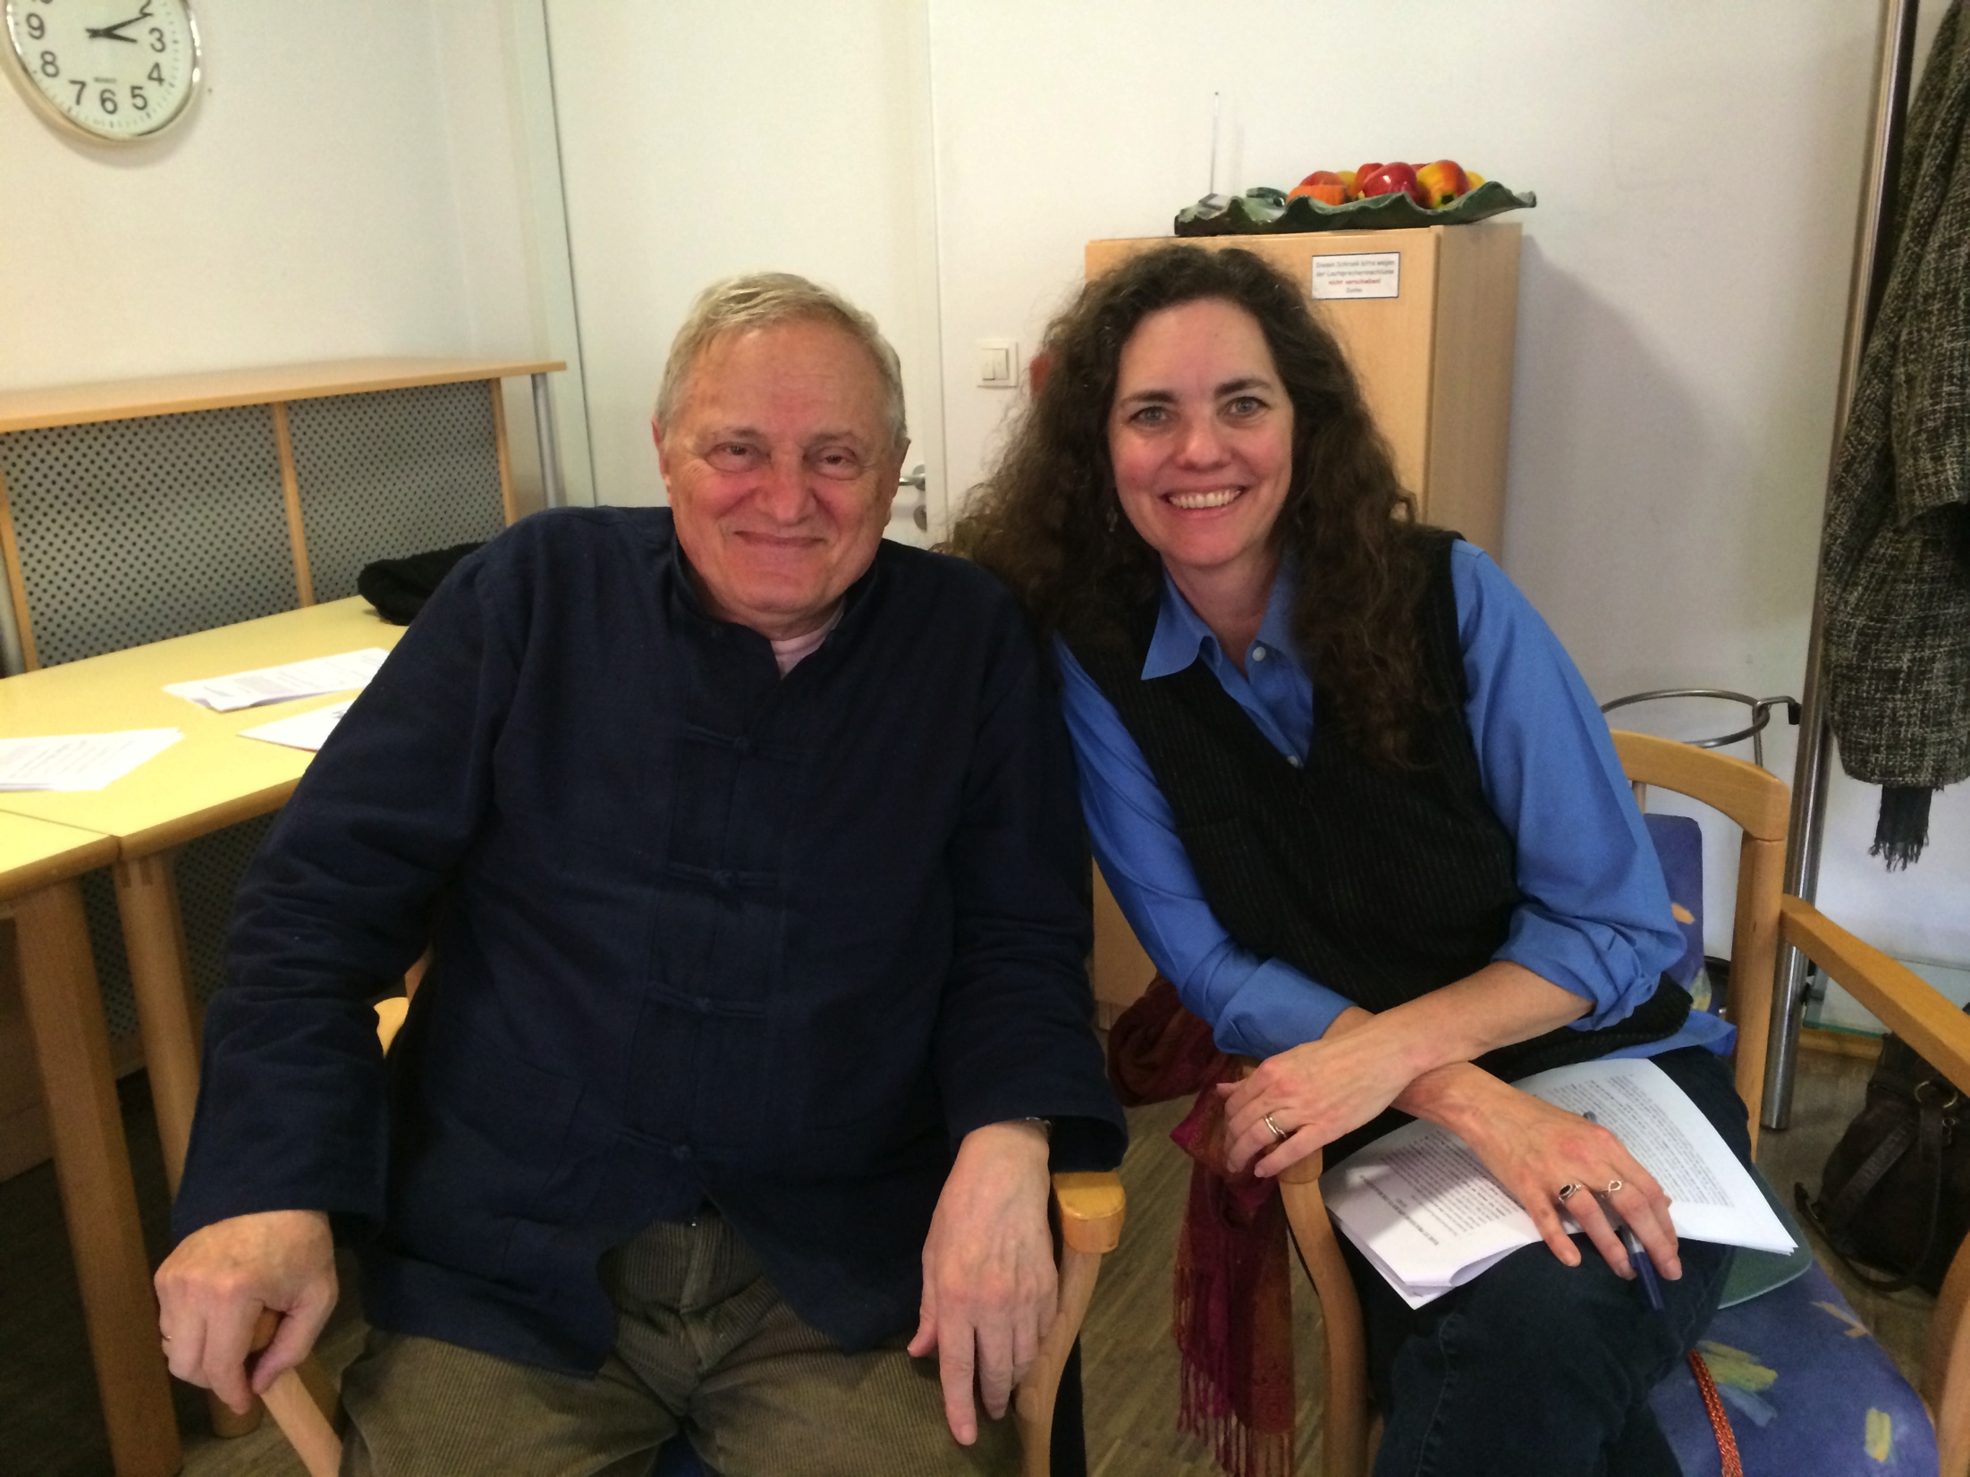
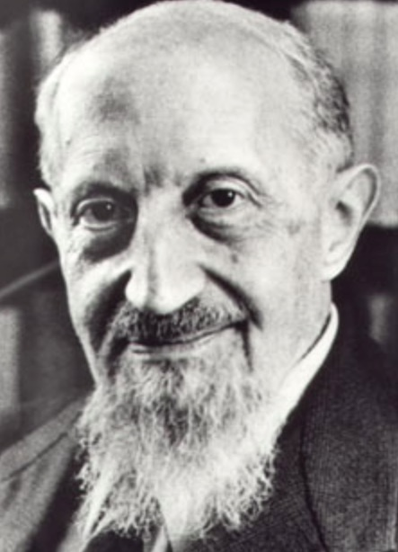
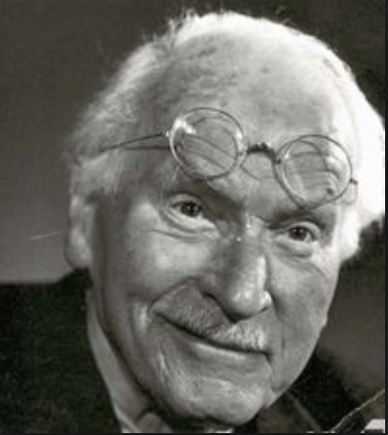
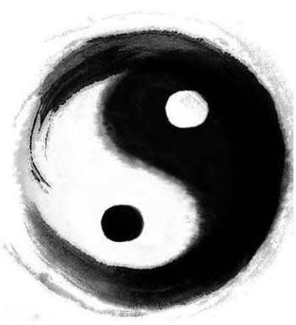
“There are two fundamental possibilities for us as conscious human beings: dualistic and unified consciousness.”
~ Zivorad M. Slavinski
Roberto Assagioli, M.D.
Carl Gustav Jung, M.D.
Non-dual philosophies

Slide 13
Skepticism / Curiosity

Slide 15
Acceptance + Integration = FREEDOM

Slide 16
Acceptance and Integration Training Theory
Psychological and interpersonal distress can be attenuated and remediated through a process of acceptance and integration of associated energetic polarities driving the distress.
Such integration results in greater acceptance of self, others and situations. The integration process produces an increased sense of freedom and an ability to make skillful choices in response to previously problematic triggering situations.
Integration methods are learned and perpetuated by training and ongoing practice of the procedures.

Slide 17
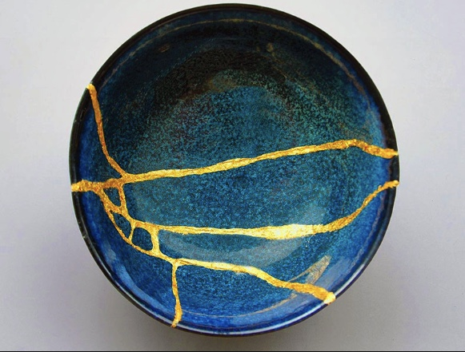
Kintsugi ~ The Art of Precious Scars

Slide 18
THOUGHTS, IMAGES, EMOTIONS AND SENSATIONS (TIES)
CHARGED TIES – tethers us to limited states

Slide 19
Case Study

Slide 20
Principles of Acceptance
and Integration Training

Slide 21
The true self is not encumbered by the limitations of a narrative. The true self is a being.

Slide 22
The integration of two opposing states can alleviate psychological suffering.

Slide 23
Self acceptance is a means and
measure of wellbeing.

Slide 24
Taking responsibility for and tending to our inner state is the source of our freedom.

Slide 25
Resolving reactivity reveals higher states of consciousness.

Slide 26
The non-dual states of empty consciousness are an indication and mechanism of transformation.

Slide 27
Spiritual Technology Principles
We take a holistic approach to problems, situations and goals. In the human
mind there is always wholeness, not independent polarities. Zivorad states,
“there are two fundamental possibilities for conscious human beings: dualistic consciousness and unified consciousness.” Most live predominantly on the dualistic plane, experiencing the tension, dramas and pains of being pulled between the attraction to one experience and aversion to another experience.
Alternative technique: this is a bi-polar universe. Thus, it is necessary to allow for and involve both sides of experience. People generally experience only one side and tend to cling to positive emotional states. This is impossible. We are naturally pulled by attractions and aversions.

Slide 28
Spiritual Technology Principles
Solve et Coagula (concentrate and dilute) – breaking down and coming together of elements into a more evolved and integrated form.
Immovability of an experience whenever it is possible: Using one snapshot not the whole of the film of the experience.
Duplication i.e. dramatization of the experiential elements (thoughts, images, emotions and sensations). Another name for this is paradoxical intention.

Slide 29
The MOST important principle, “On a low level of consciousness there are no solutions, and on high level of consciousness there are no problems.”
~ Roberto Assagioli, MD

Slide 30
Phases of Acceptance and Integration Training
Collaborative Agreement
Discovery
Integration
Embodiment
Directed Awareness

Slide 31
Acceptance and Integration Training
Helping ourselves and our clients wake up from the bad dream of who we think we are, shifting identification from the conditioned self to the true self.
www.aait.solutions

Slide 32
Next Steps
Practice. Practice. Practice.
Join our Facebook Community – AAITCommunity.com
Continue learning – apply for the AAIT Fellowship Training Group, 2021

